Slide 1
DevelopHER 2016
Proudly sponsored by MYOB

Slide 2


Slide 3
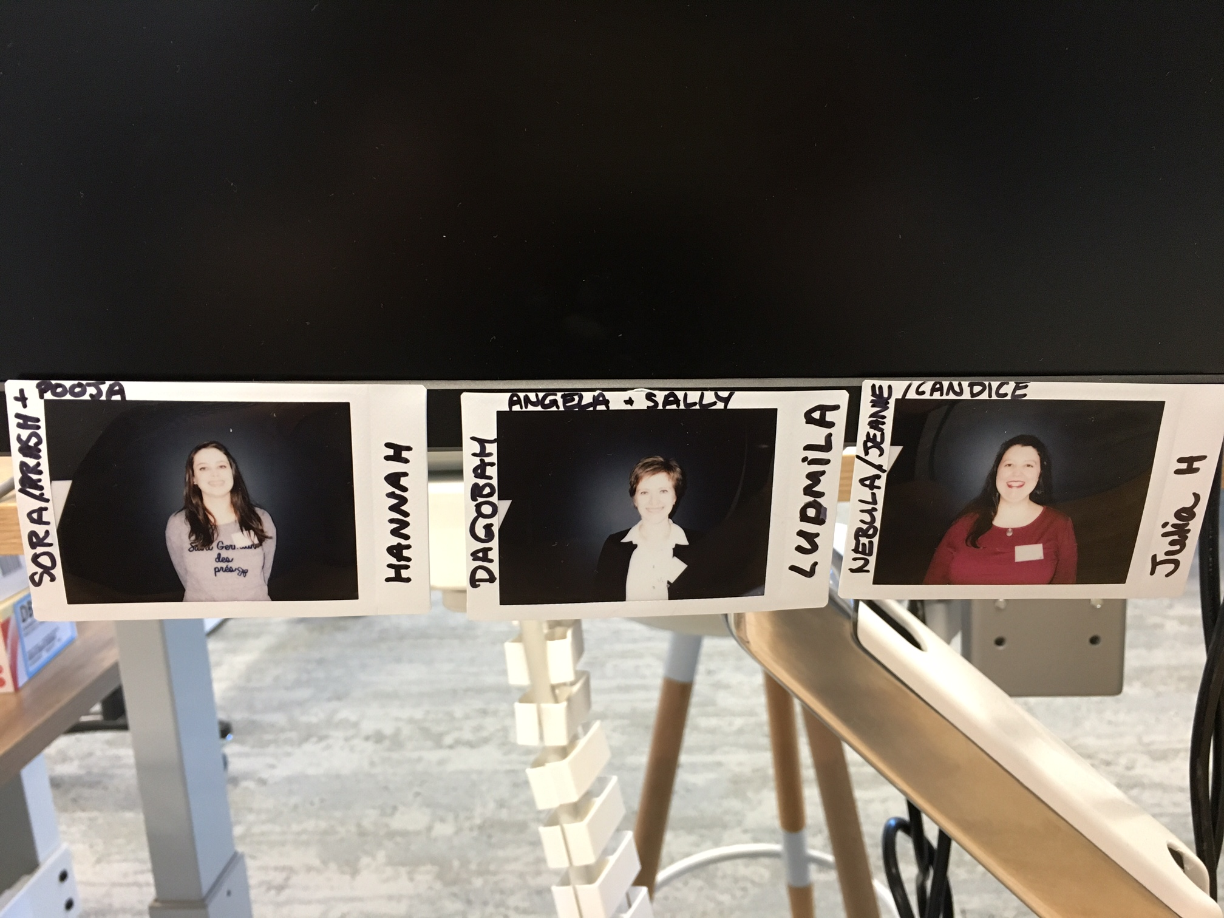
Chosen DevelopHERs
Hannah Deutscher
Ludmila Stakhovych
Julia Harper
Photos taken on the interview day, showing us full of excitement and hope! We had no idea they would be a permanent fixture on Tanya’s desk! The first of many great poses.

Slide 4
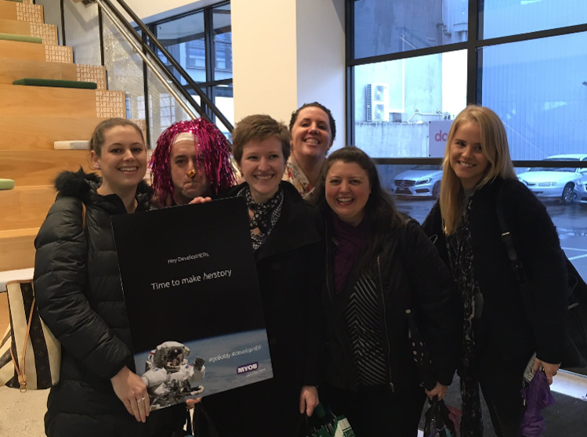
First day as DevelopHERs
It was our first day at MYOB as DevelopHER interns.
Here comes the description.

Slide 5
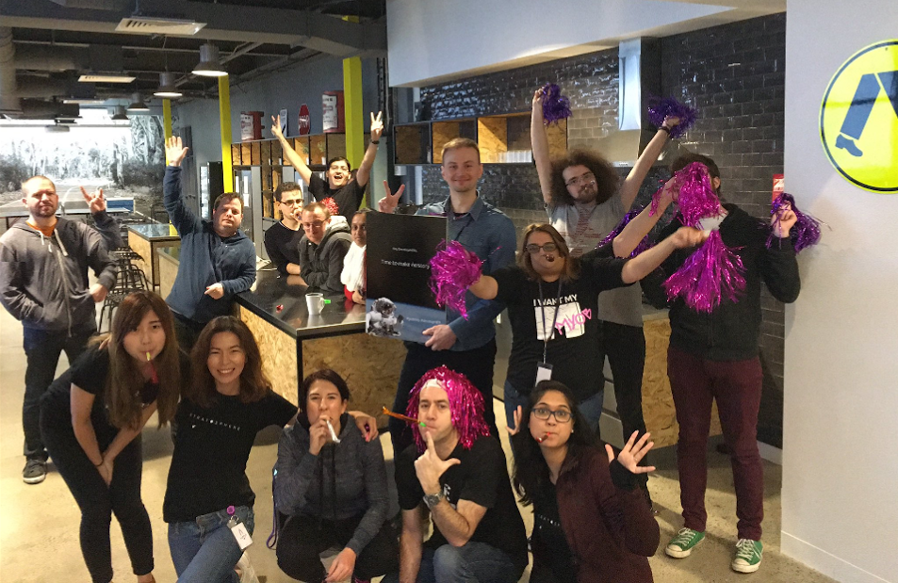
DevelopHERs welcoming celebration
An epicly enthusiastic welcome from the team we would come to know and love! Don’t worry Andrew, we can still see you behind Mandy’s third arm, and Dan is managing to keep both hands in his pockets whilst also giving a rock salute ☺

Slide 6
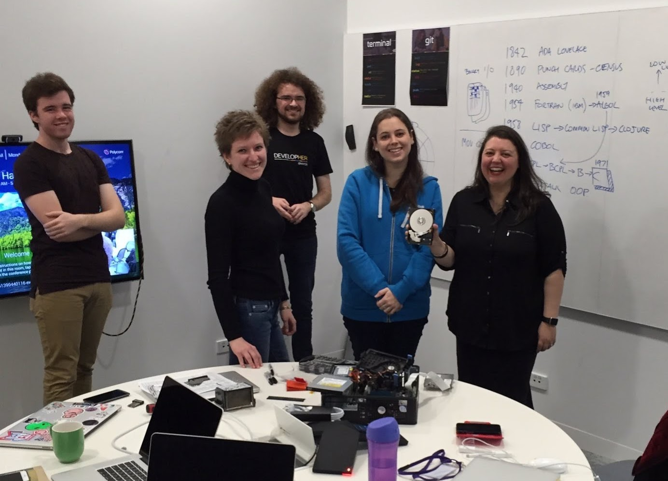
Classroom session
First day in the classroom – history of SW development

Slide 7
Learning Agile Manifesto Terminal & Git Commands

Slide 8
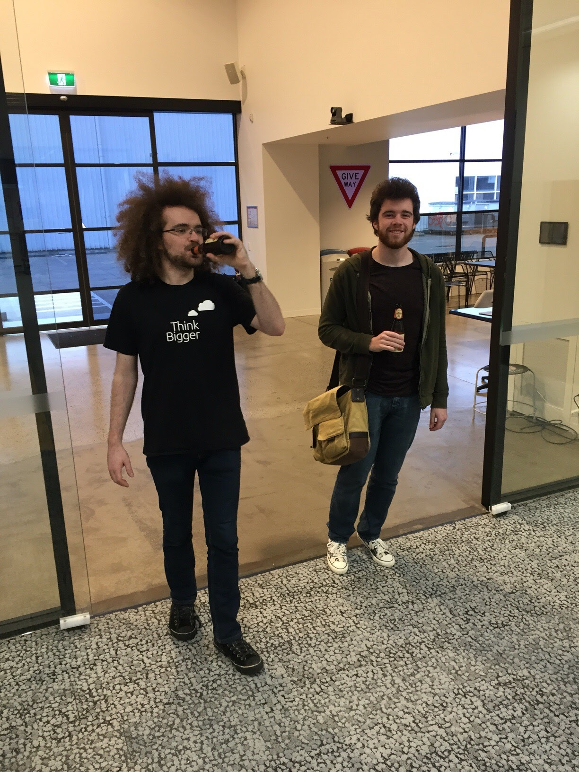
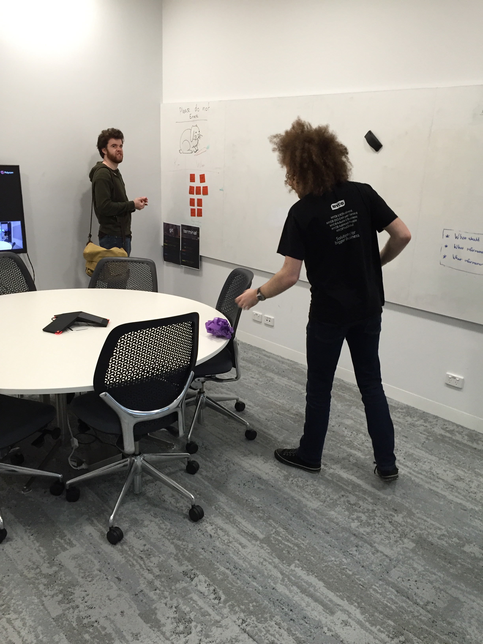
Teachers
description

Slide 9
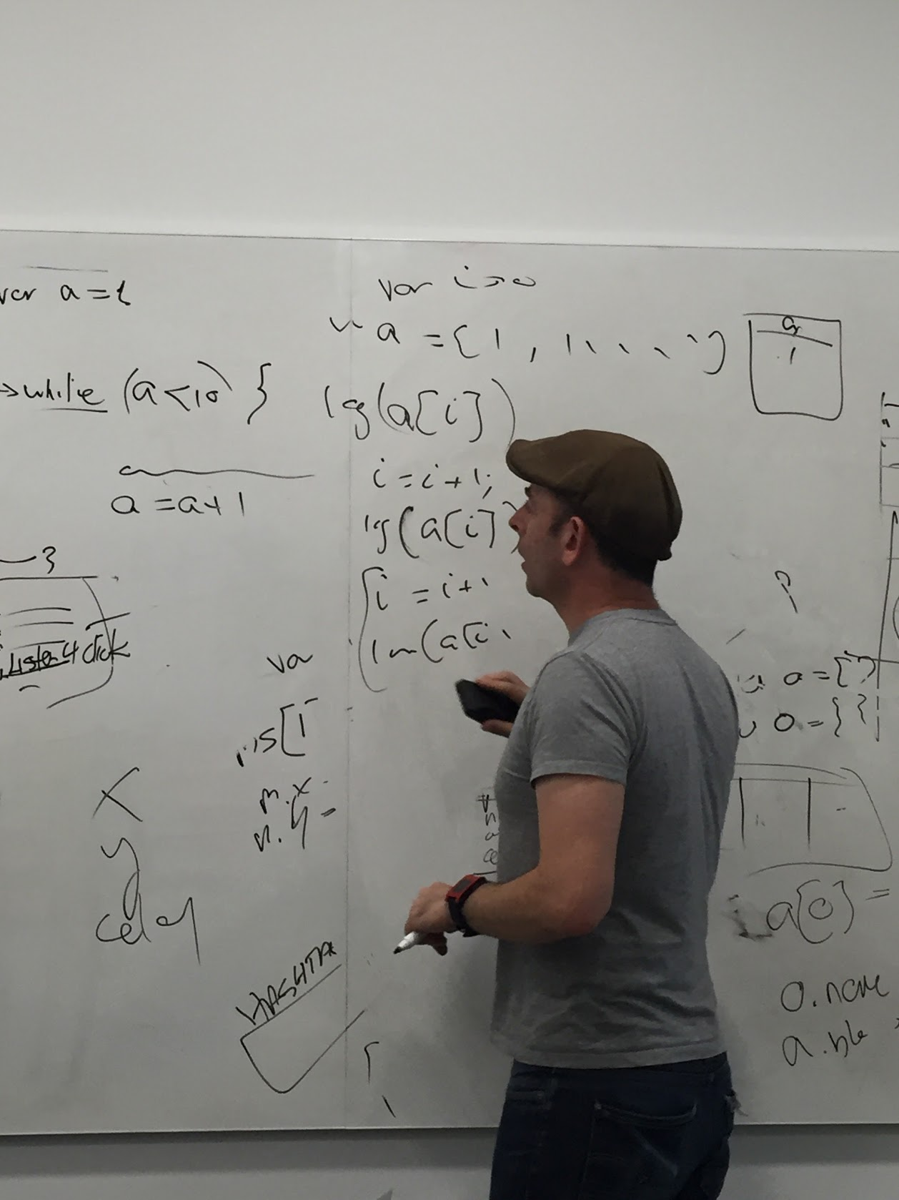
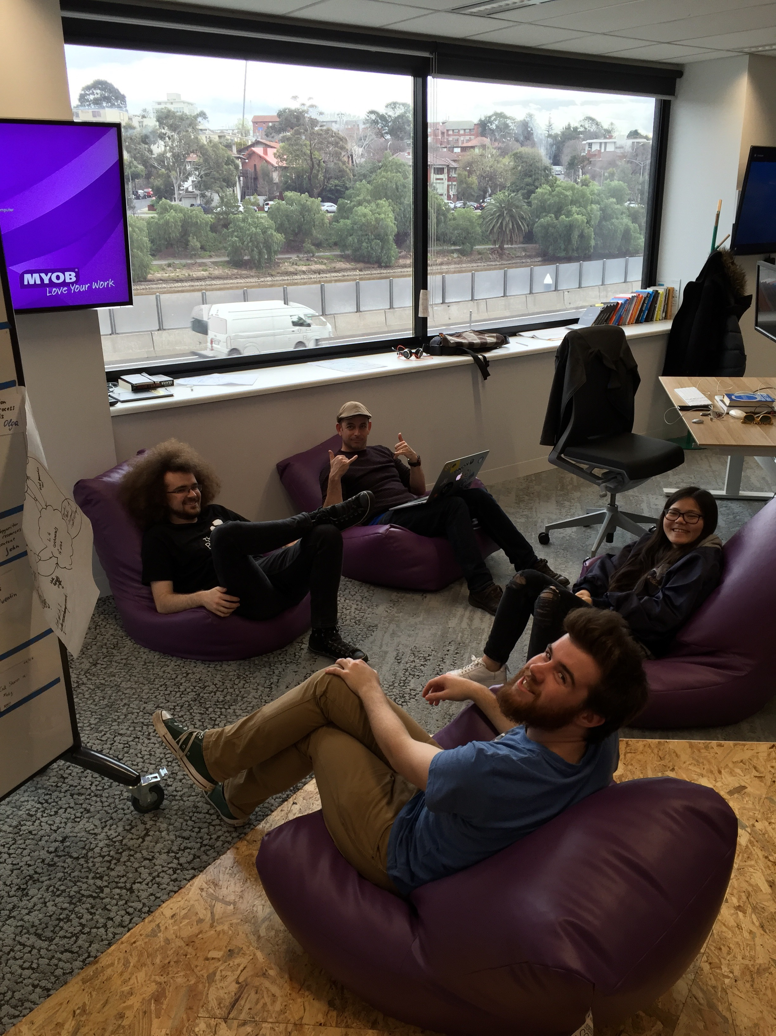
SRA
The atmosphere is ramping up, things are being put into boxes using equals, and there’s the sound of cyborg camera lenses scanning the room. SRA is in the house!

Slide 10
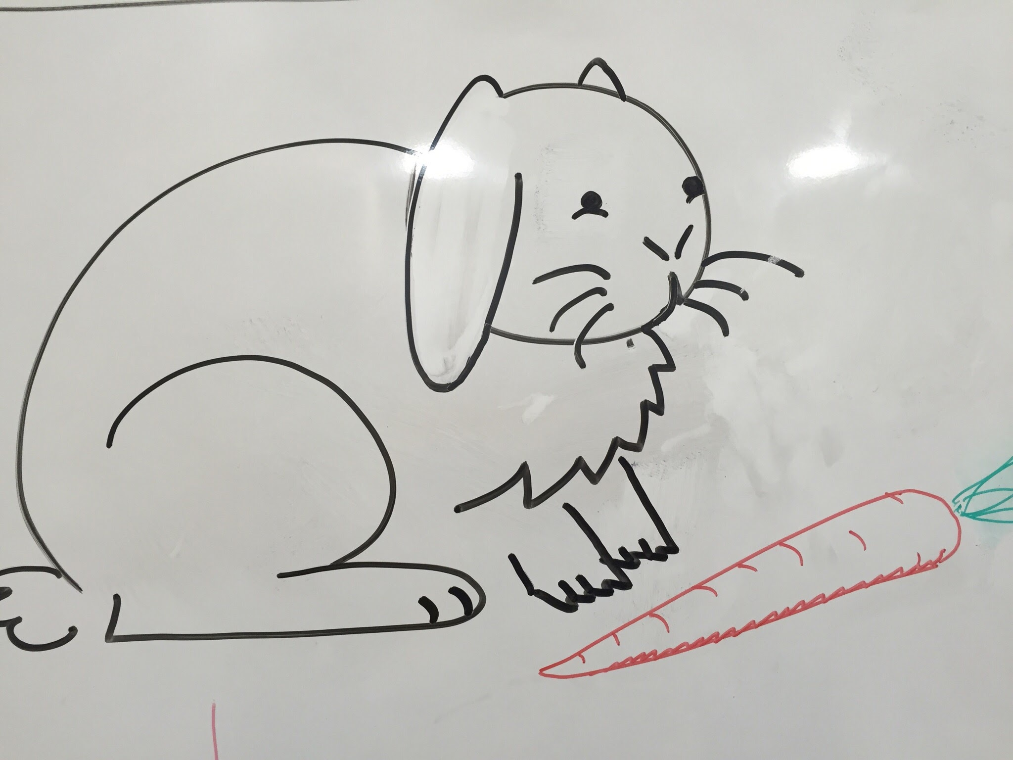
Lovely rabbit
Description

Slide 11
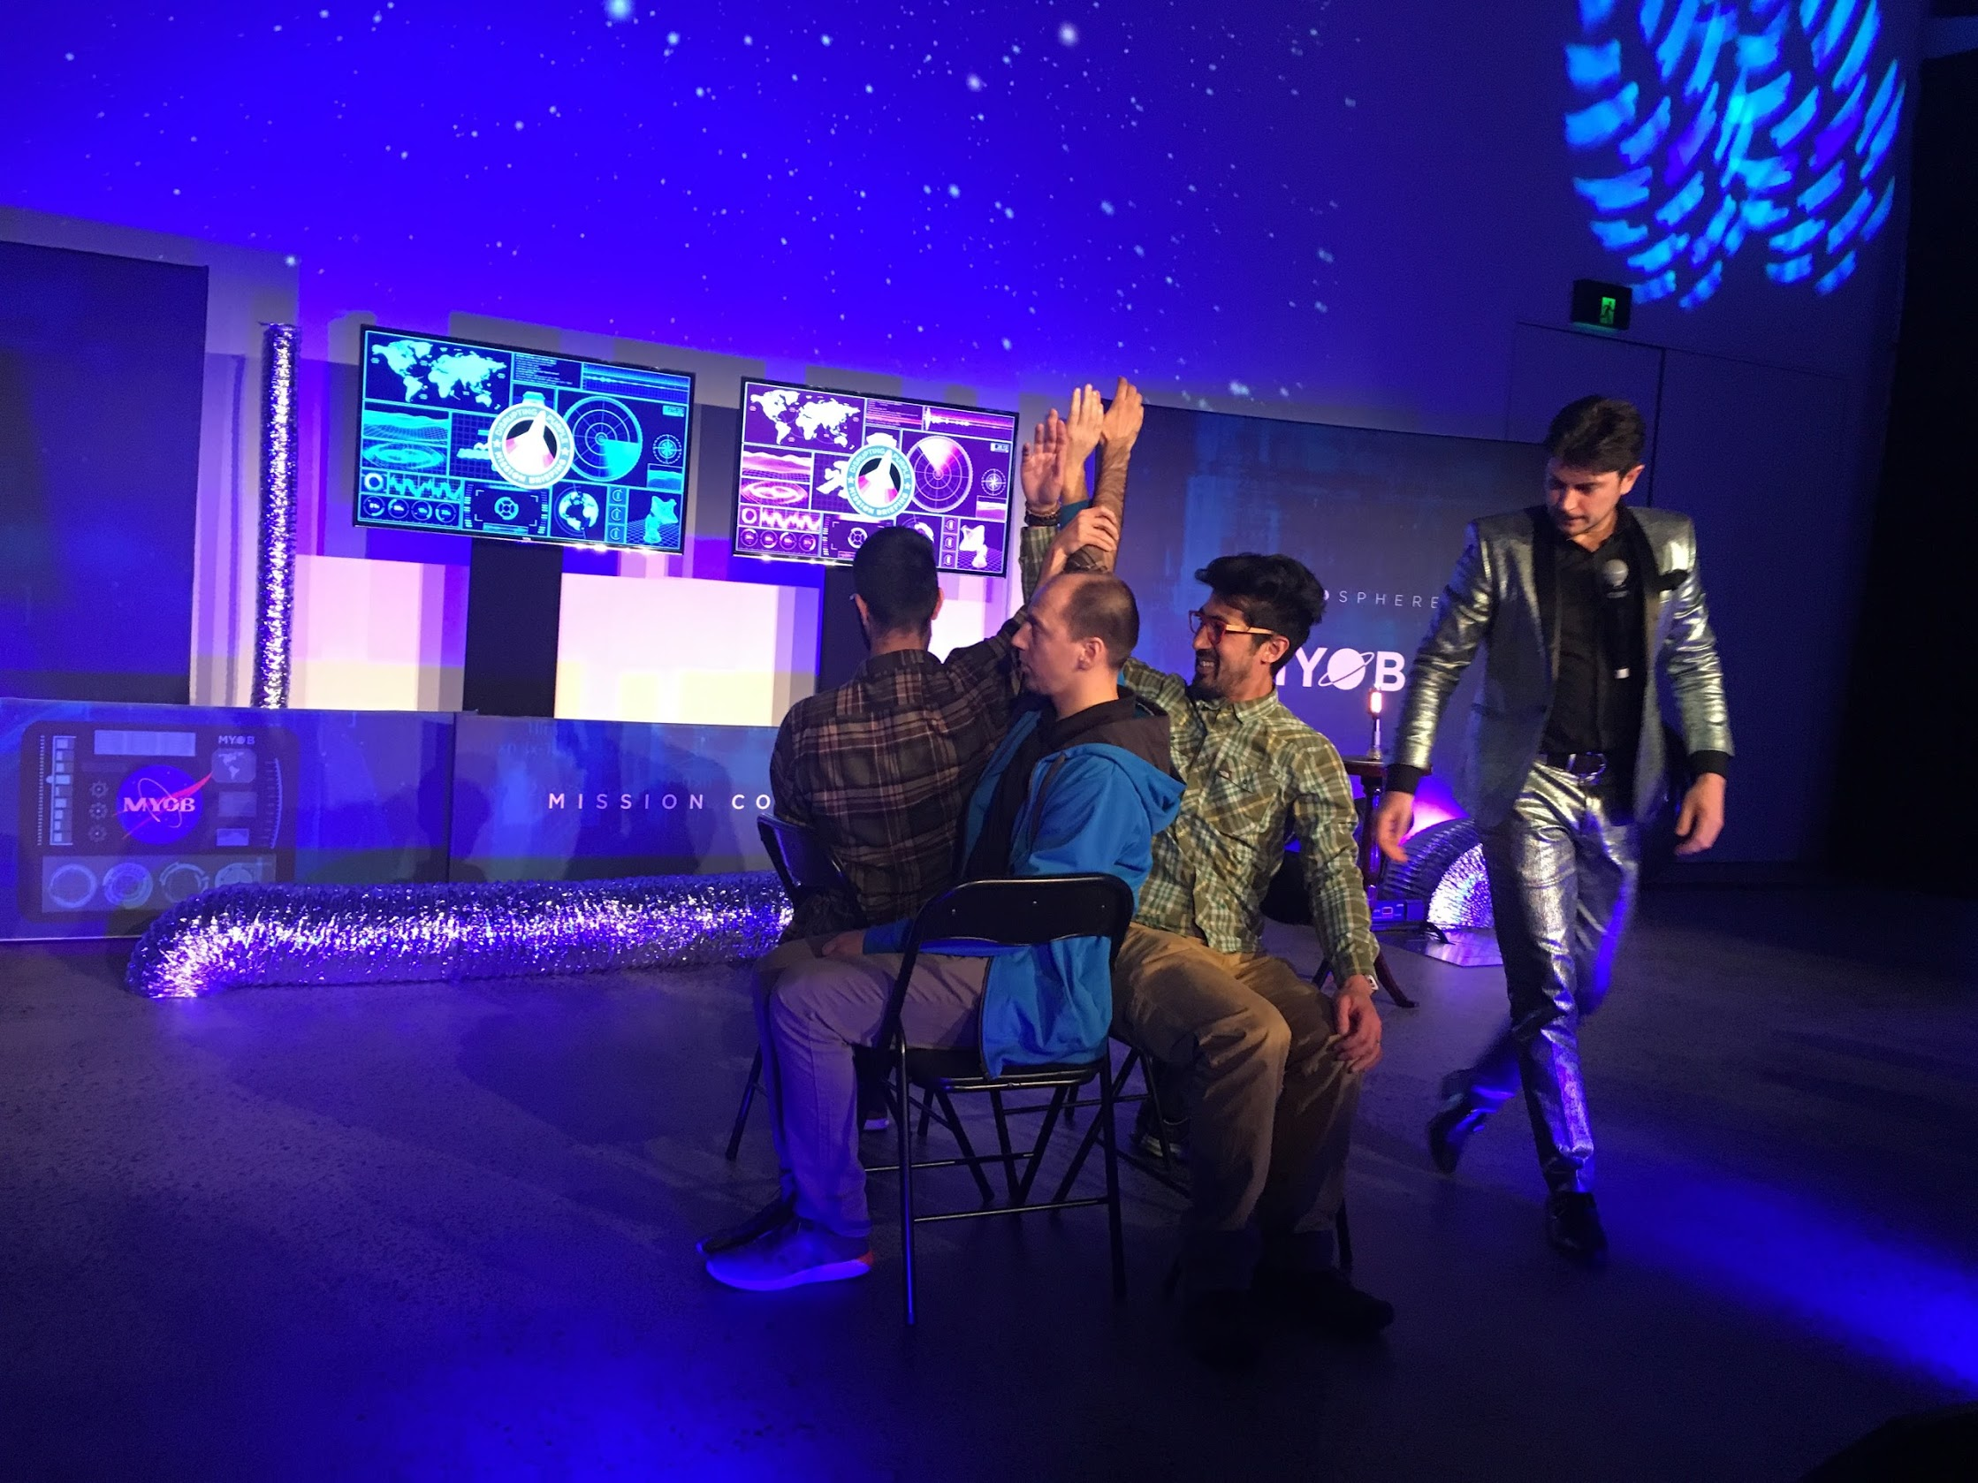
Disrupting Purple
Our first official company event – rocket ships, dancing storm troopers and awesome sweet treats, plus watching these guys do incredible feats of strength! Blown away by the passion and culture of myob!

Slide 12
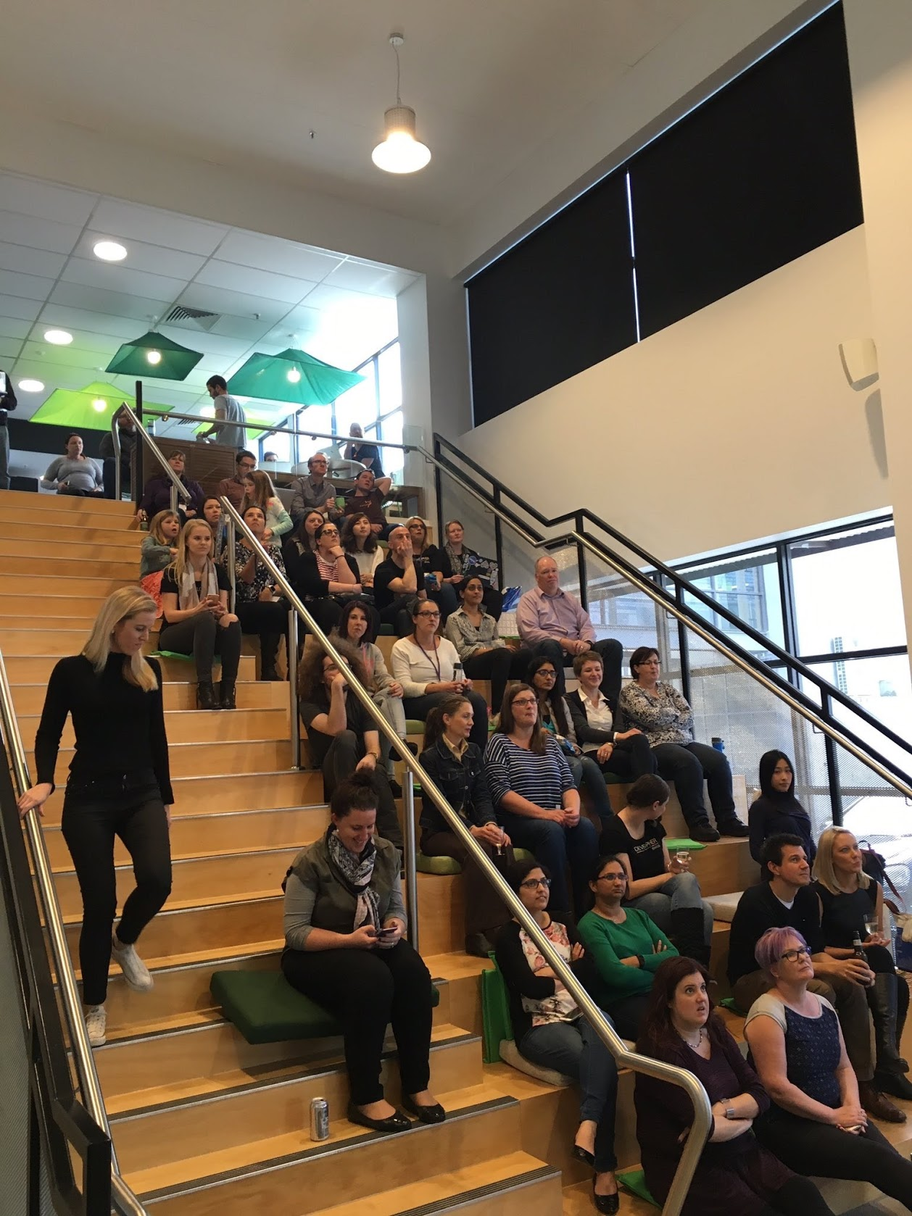
Code: Debugging The Gender Gap (A Documentary)
Description

Slide 13
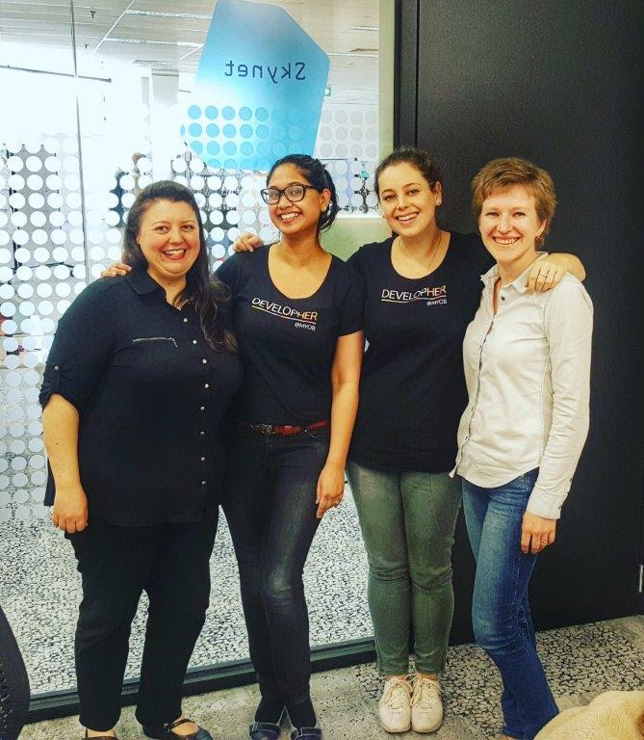
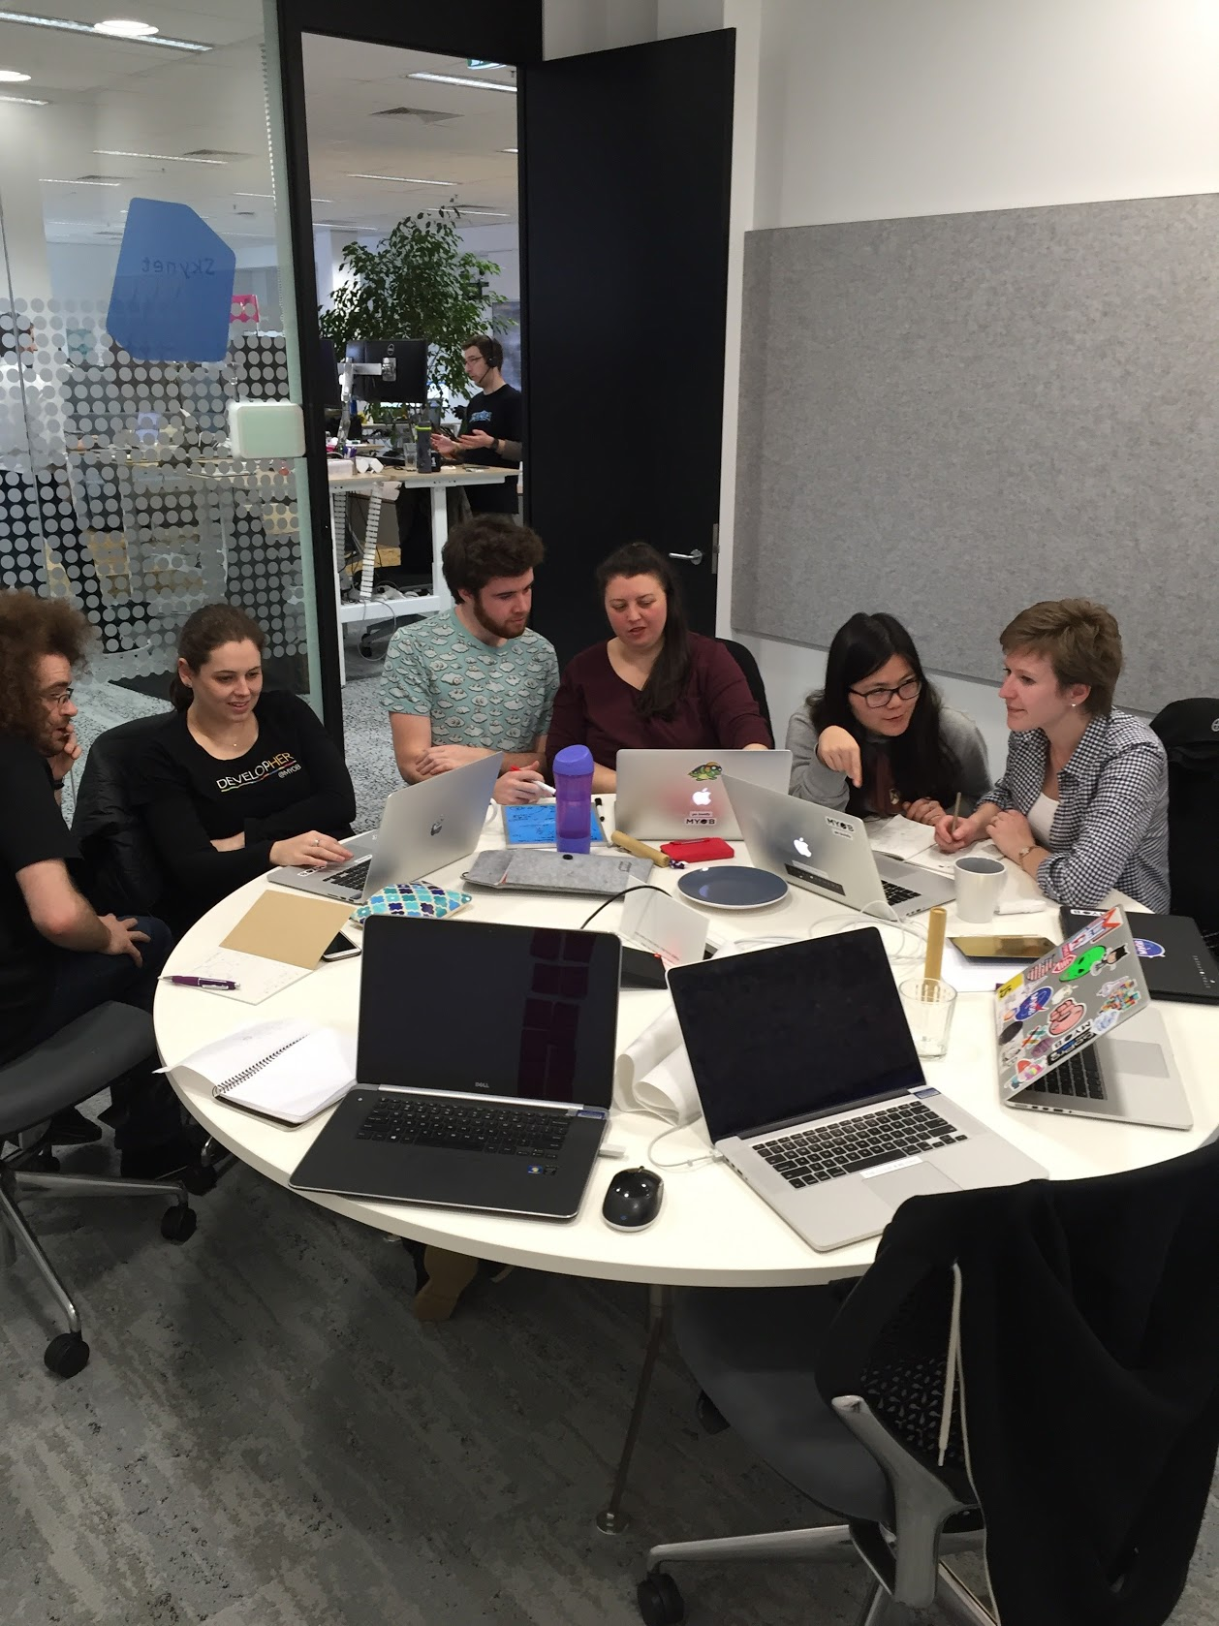
Classroom experience
Description

Slide 14
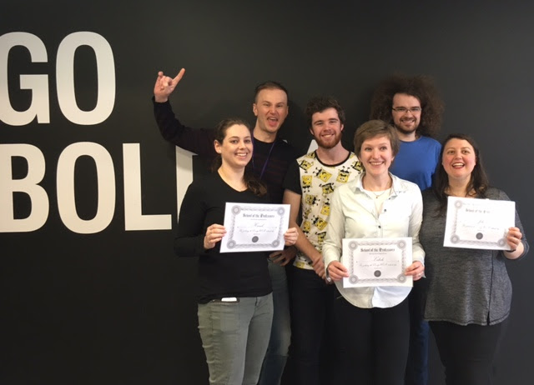
Graduation

Slide 15
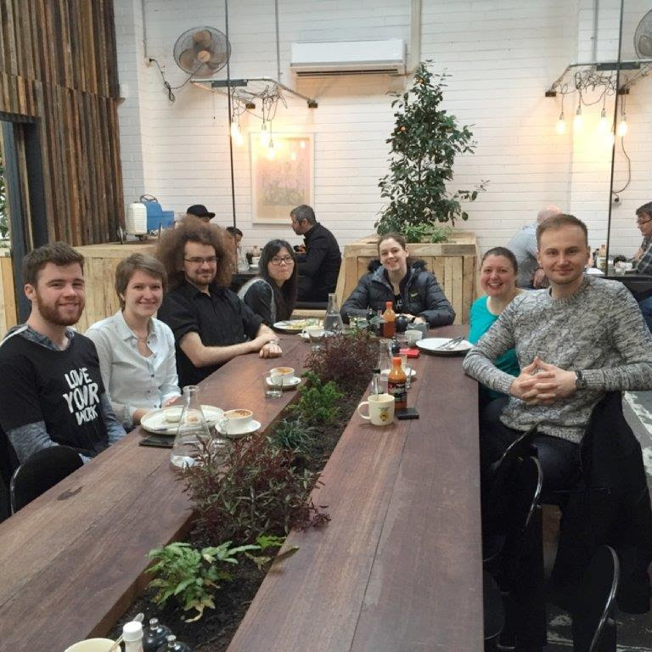
End of learning in the class
Description

Slide 16
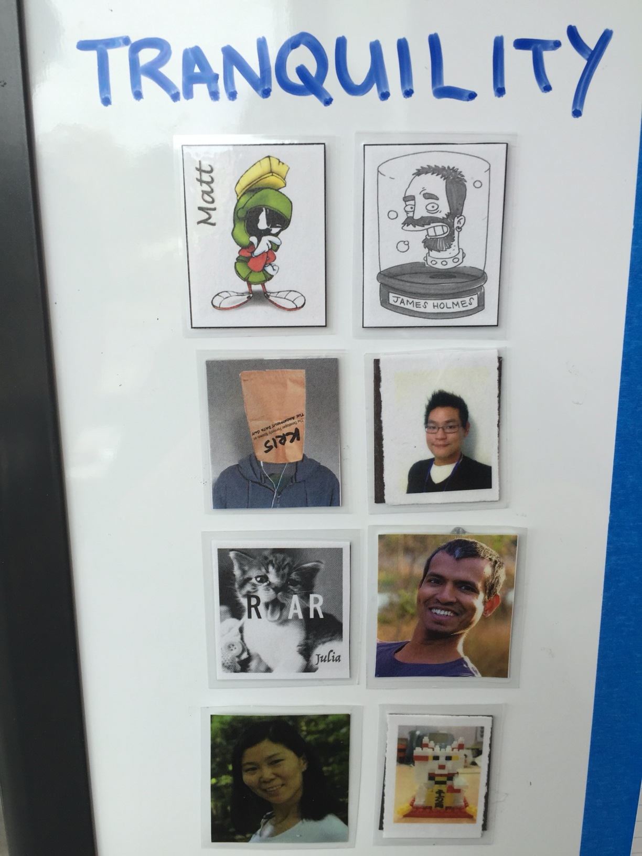
Teams we are working in (make a name)
Description
Bla
bla
bla

Slide 17
Sora
Hannah please add a picture and some description

Slide 18

Genesis team is responsible for delivering the Essentials Rebrand / Brand Integration stream of work.
Rebrand team (Genesis) to update old stack pages in essentials by:
Creating reusable react components
Updating styles to reflect new visual designs
Purpose:
To incrementally evolve Essentials into a simplified, modern and intuitive product experience, which will help us surpass the market share of our SME competitors.
Continual transformation of Essentials will improve product experience that will help our customer and partner businesses succeed.

Slide 19
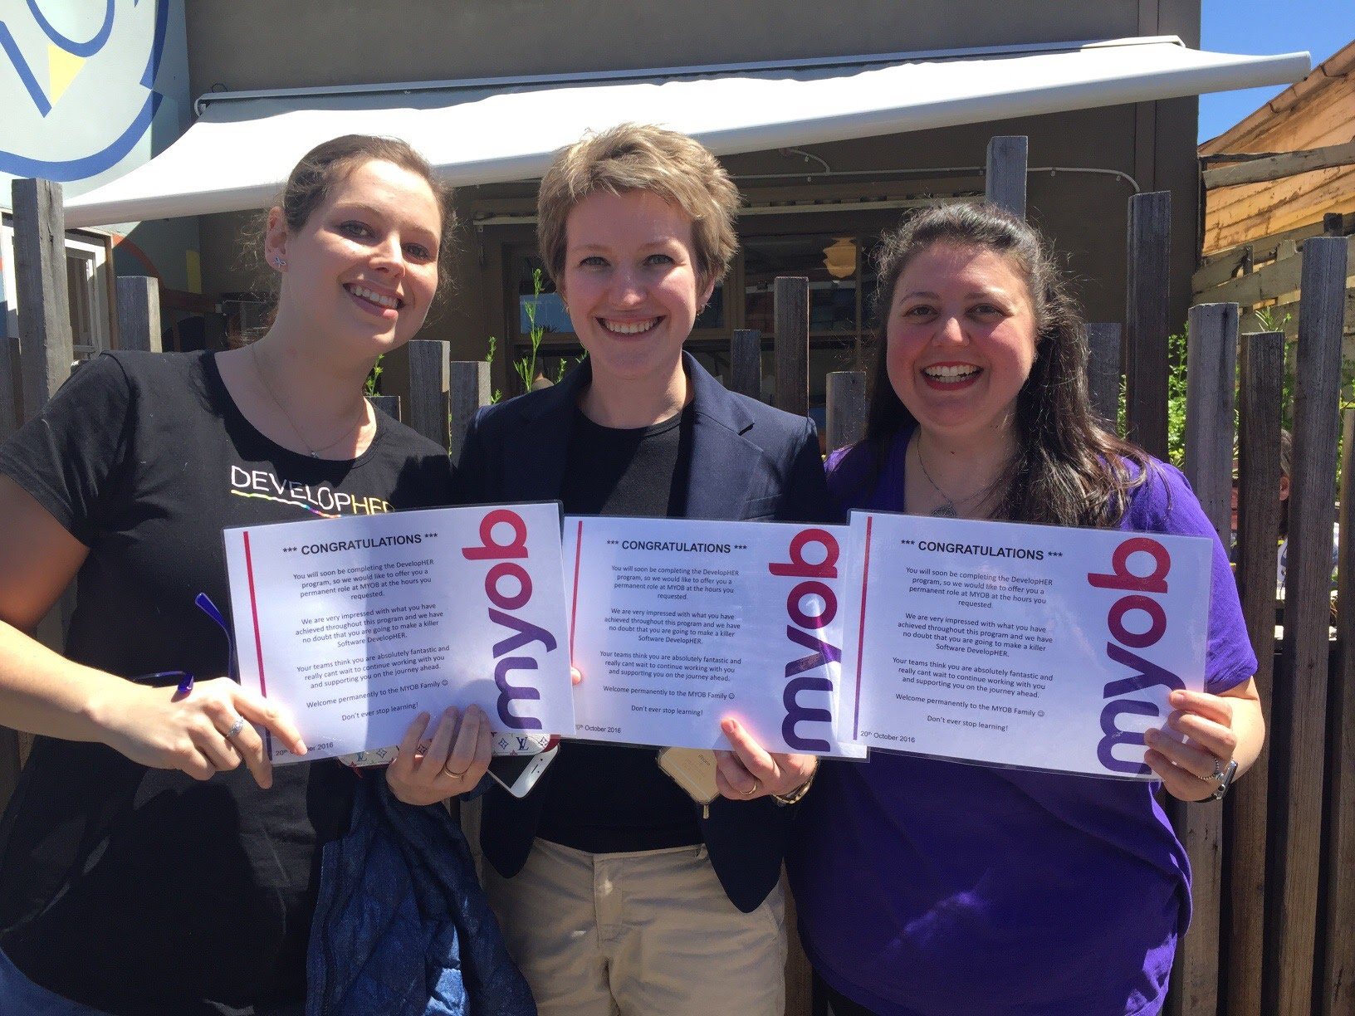
Graduate Developers
Description

Slide 20
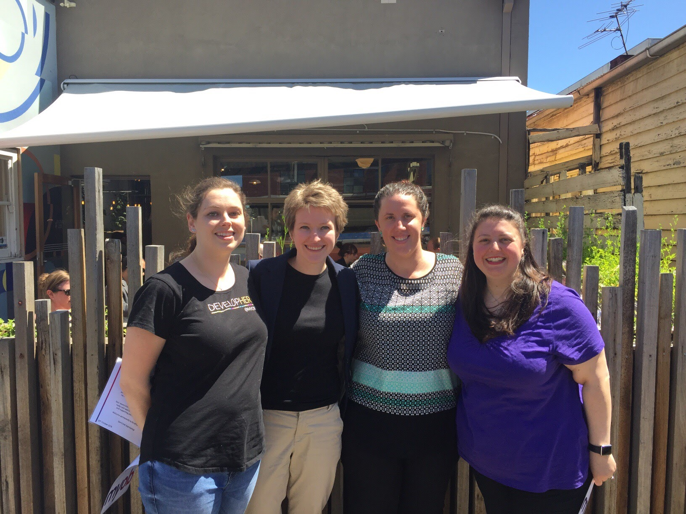
Contracts celebration
Description

Slide 21
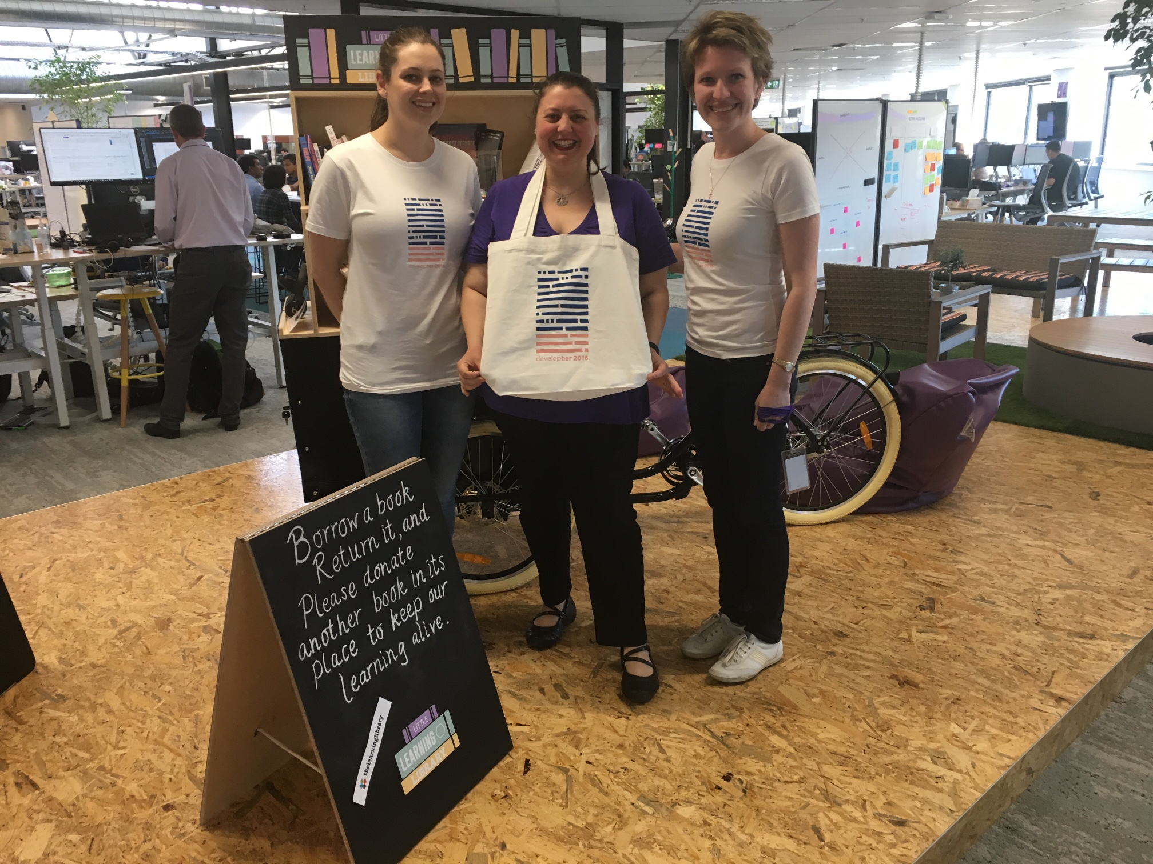
New DevelopHER T-shirts and tots
Thanks to Nick and Jeanie for their awesome job in creating new DevelopHer 2016 t-shirts and tots.

Slide 22
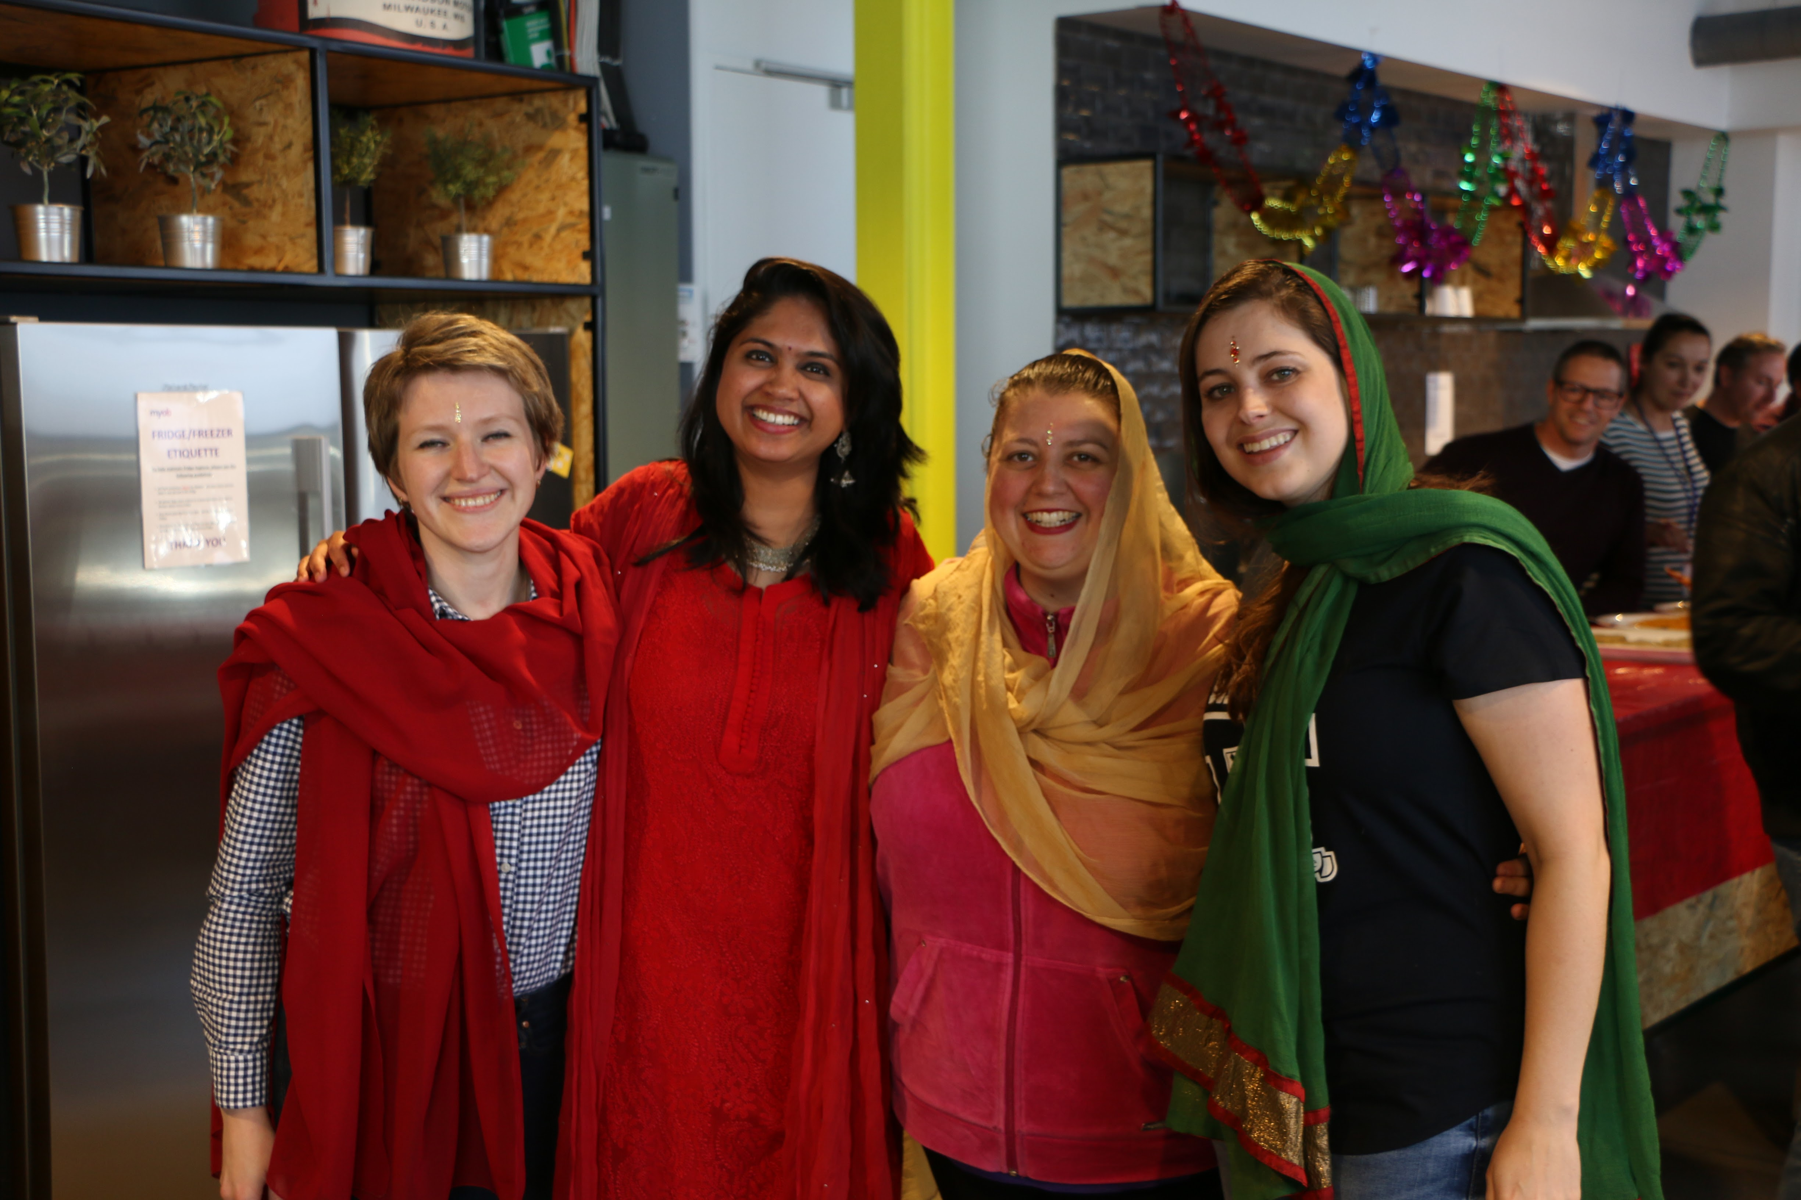
Diwali celebration
gjfjhgjhg

Slide 23
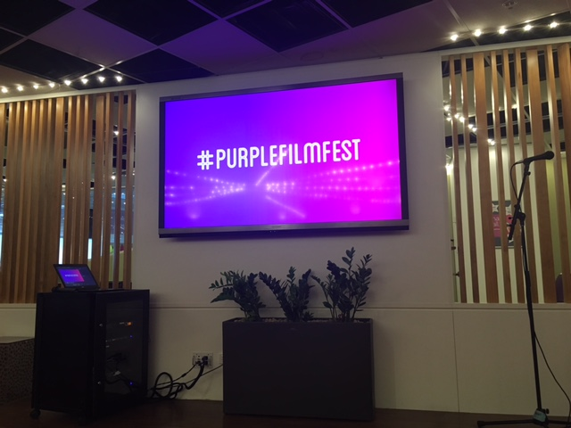
Purple Film Fest 2016

Slide 24


Slide 25
Acknowledgements
John Sullivan
Tanya Windscheffel
Katherine Smyth
Andrew Bail
Angela Yu
Candice Nel
Clinton Eidelman
Dan Harper
Jeannie Kang
Jatin Bhasin
Jigger Fantonial
Jonathan Broome
Mandy Hicks
Mark Barber
Michael Shannon
Nick Bligh
Ognjen Babic
Pooja Elkunchwar
Prash Sagar
Sally Higgs
Simon Raik-Allen
Vidya Narasimhan
Vivian Chi
Nebula team
Sora team
Tranquility team
Genesis team

